Slide 1

Battle of Neighbourhoods
Capstone
Applied
Data Science
New Restaurant Location Recommeder Project

Slide 2

About the Project
Battle of Neighbourhoods
This project aims to locate and recommend to my user which neighbourhood in New York City will be the best choice to start a restaurant.
The user is a successful Indian restaurant chain owner in India and Canada is looking to expand operation into North America through New York (NYC).
The project provides data and insights to:
NYC Population & Demographic characteristics
Who are the competitors in that location?
Web scraping techniques have been used to get NYC's population density and demographics data from Wikipedia.
Data source: https://cocl.us/new_york_dataset and Foursquare API. These dataset was used to explore various neighbourhoods and each Indian restaurants venues in the neighbourhood.

Slide 3
Data Acquisition
Wikipedia
Part 1: NYC Population & Demographic characteristics
https://en.wikipedia.org/wiki/New_York_City ;
https://en.wikipedia.org/wiki/Demographics_of_New_York_City.
Web scraping techniques have been used to get NYC's population density and demographics data from Wikipedia.
Part 2: Who are the competitors in that location?
: https://cocl.us/new_york_dataset and Foursquare API. These dataset was used to explore various neighborhoods and each Indian restaurants venues in the neighborhood.

Slide 4
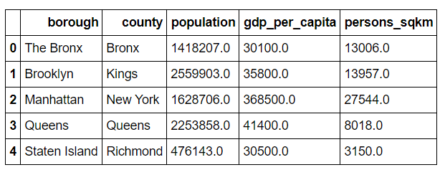
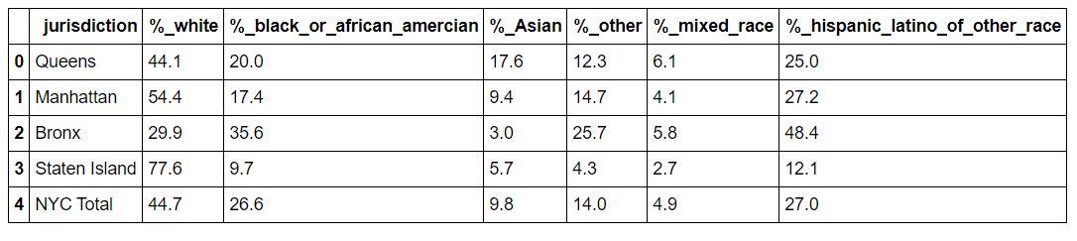
NYC Population & Demographic characteristics
Gathering population data and obtaining population density on the basis of races

Slide 5
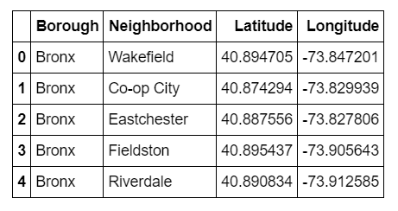
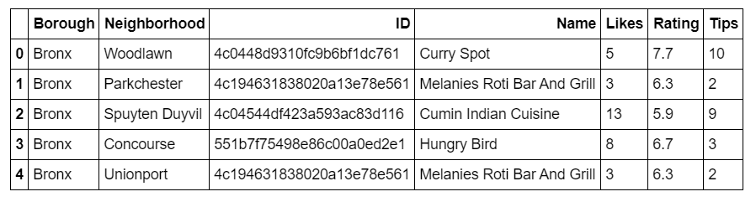
Obtaining Boroughs and Neighbourhoods in a 1000m radius
Finding restaurants alongside their like count, rating and tips count

Slide 6
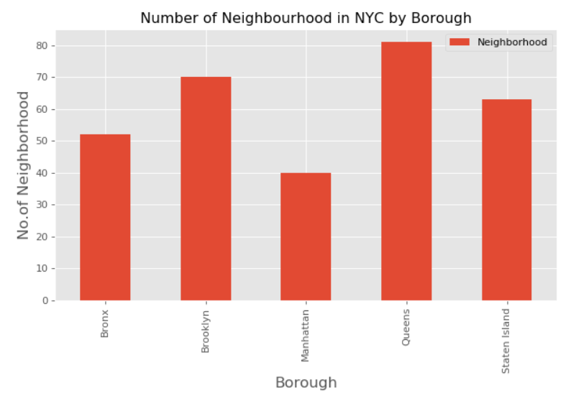
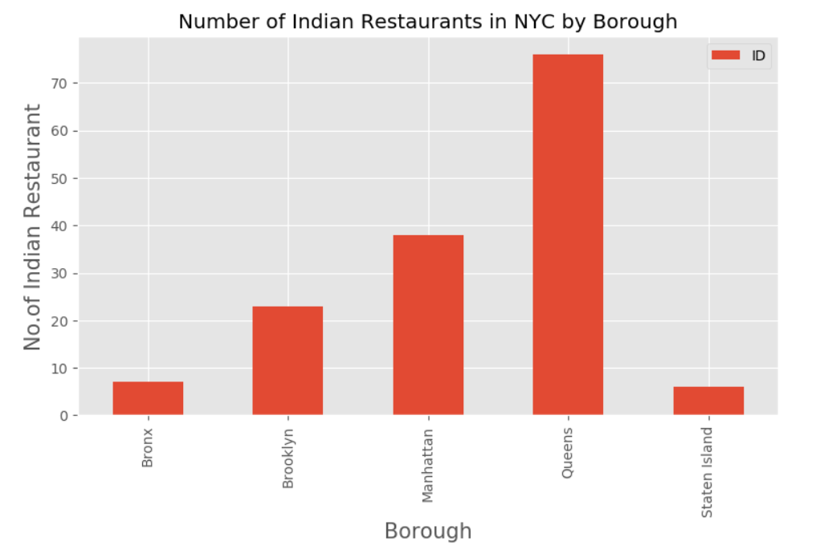
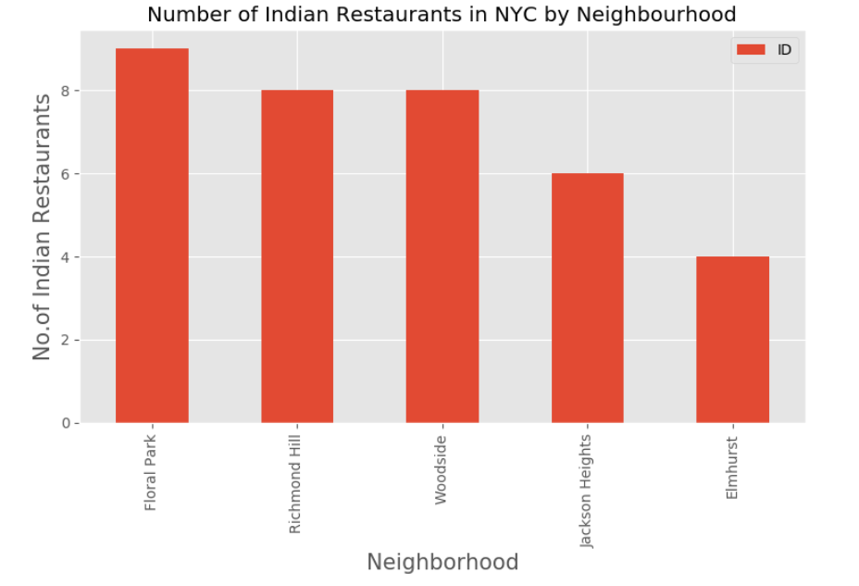
Classifying the number of neighbourhoods in NYC
Finding restaurants in NYC by neighbourhoods and boroughs

Slide 7
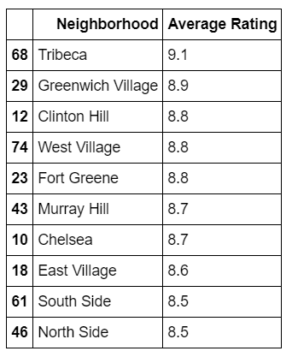
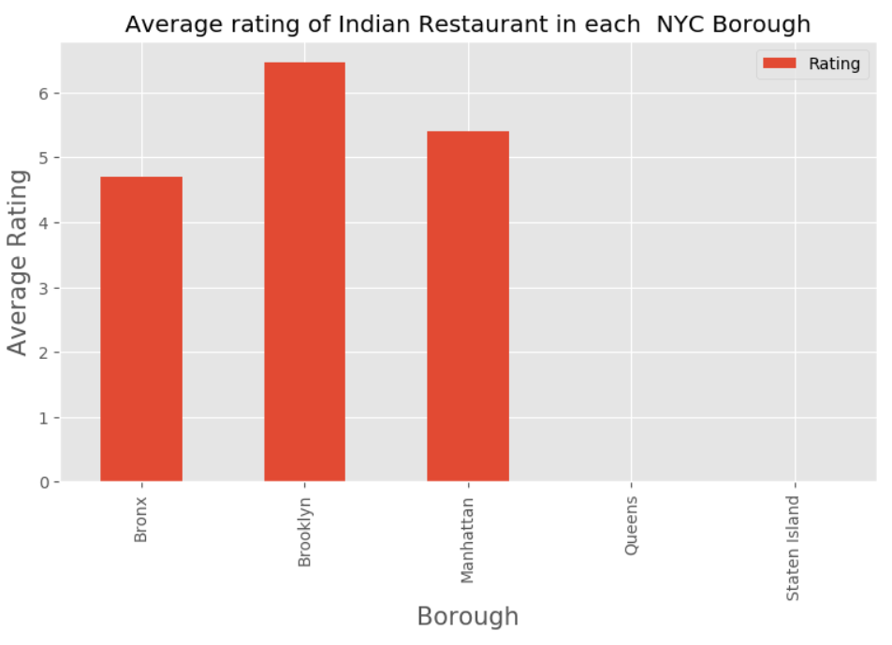
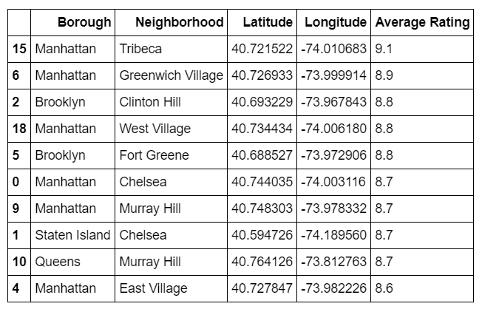
Average Rating of Restaurants
Finding restaurants in NYC by neighbourhoods and boroughs

Slide 8

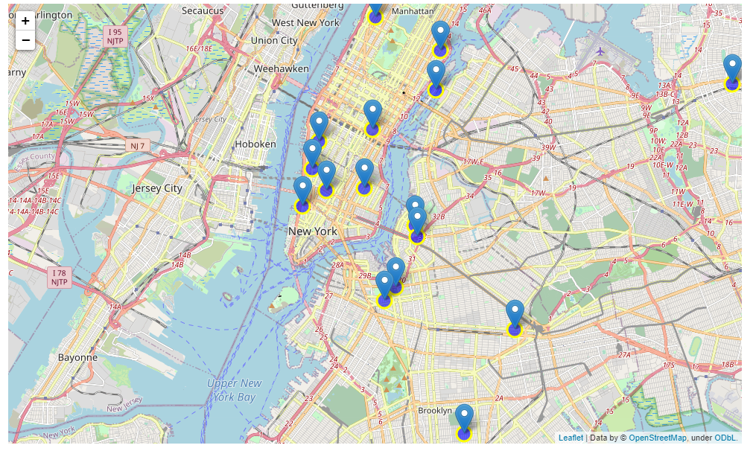
Obtaining the locations on Map

Slide 9
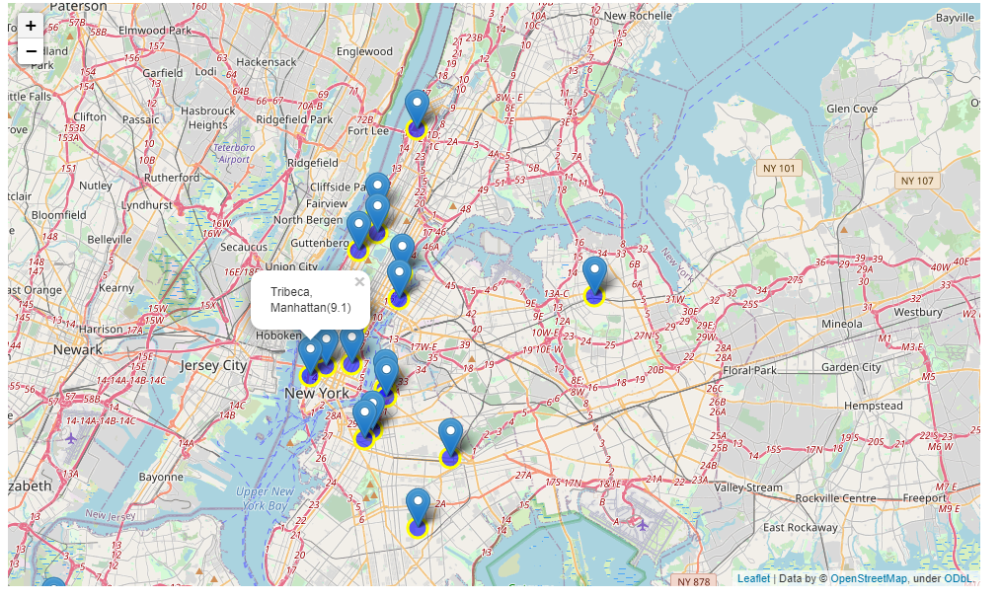
Obtaining the locations on Map

Slide 10
Results
Inferences
Clinton Hill, Tribeca, Greenwich Village in Manhattan are some of the best neighborhoods for Indian cuisine.
Bronx has the lowest rated Indian Restaurants in NYC.
Manhattan is the best place if someone prefers Indian cuisine.
Tribeca or Greenwich Village in Manhattan would be the best choice to start a restaurant given that:
It is the third most populous urban area in New York city.
It has a population density of 27,544 people per square km, highest of any borough in the United States.
It has some of the top rated Indian restaurants located in that area.
It has the second highest Asian ethnic minority population in NYC.

Slide 11
Thank You.
Capstone
Akshat Singh Email ID: akshat3sep@gmail.com
Linkedin: https://www.linkedin.com/in/akshat3sep/
Applied Data Science
Akshat Singh
akshat3sep@gmail.com

